Slide 1
SYNTAX ANALYSIS
OR
PARSING
Lecture 06

Slide 2
FOLLOW EXAMPLE
S → a S e | B
B → b B C f | C
C → c C g | d | ε
FIRST(C) =
FIRST(B) =
FIRST(S) =
FOLLOW(C) =
FOLLOW(B) =
FOLLOW(S) = {$}
Assume the first non-terminal is the start symbol
If A is start symbol, put $ in FOLLOW(A)
2. Productions of the form B → α A β,
  Add FIRST(β) – {ε} to FOLLOW(A)
Productions of the form B → α A or
B → α A β where β ⇒* ε
  Add FOLLOW(B) to FOLLOW(A)

Slide 3
FOLLOW EXAMPLE
S → a S e | B
B → b B C f | C
C → c C g | d | ε
FIRST(C) = {c,d,ε}
FIRST(B) = {b,c,d,ε}
FIRST(S) = {a,b,c,d,ε}
FOLLOW(C) =
FOLLOW(B) =
FOLLOW(S) = { }
_{{f,g} ∪ FOLLOW(B)}
_{= {c,d,e,f,g,$}}
_{{c,d} ∪ FOLLOW(S)}
_{= {c,d,e,$}}
_{$, e}

Slide 4
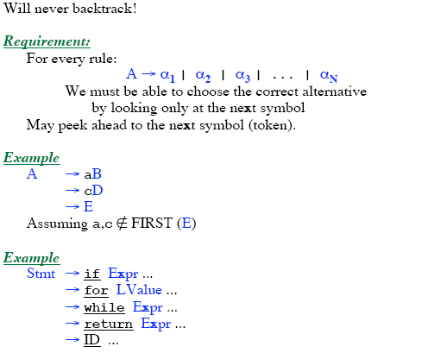
PREDICTIVE PARSING

Slide 5
PREDICTIVE PARSING
LL(1) Grammars
  Can do predictive parsing
  Can select the right rule
  Looking at only the next 1 input symbol
    First L : Left to Right Scanning
    Second L: Leftmost derivation
    1 : one input symbol look-ahead for predictive decision
LL(k) Grammars
  Can do predictive parsing
  Can select the right rule
  Looking at only the next k input symbols
Techniques to modify the grammar:
  Left Factoring
  Removal of Left Recursion
LL(k) Language
  Can be described with an LL(k) grammar

Slide 6
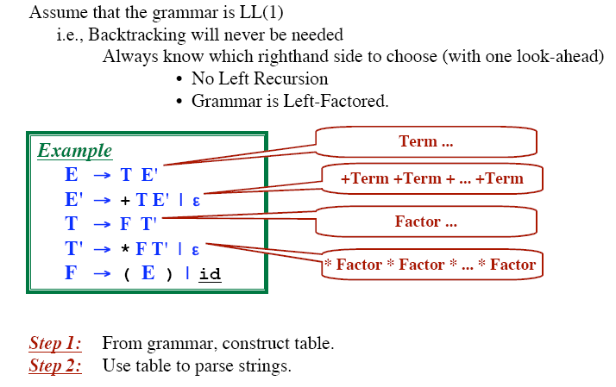
TABLE DRIVEN PREDICTIVE PARSING

Slide 7
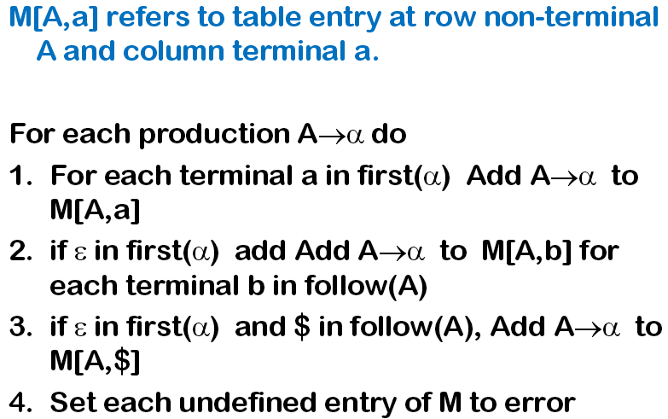
PARSE TABLE CONSTRUCTION

Slide 8
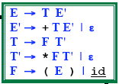
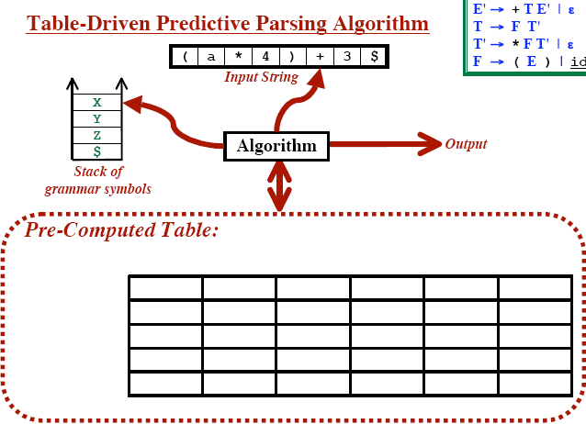
TABLE DRIVEN PREDICTIVE PARSING

Slide 9
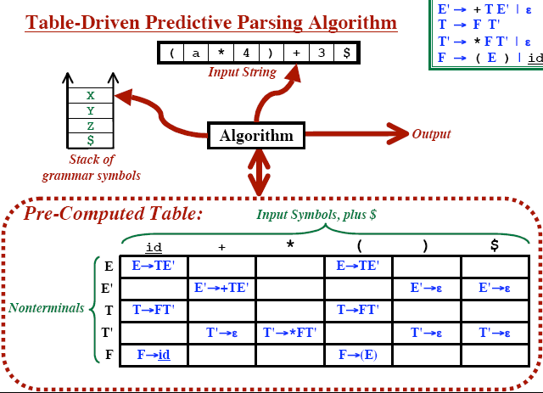
TABLE DRIVEN PREDICTIVE PARSING

Slide 10
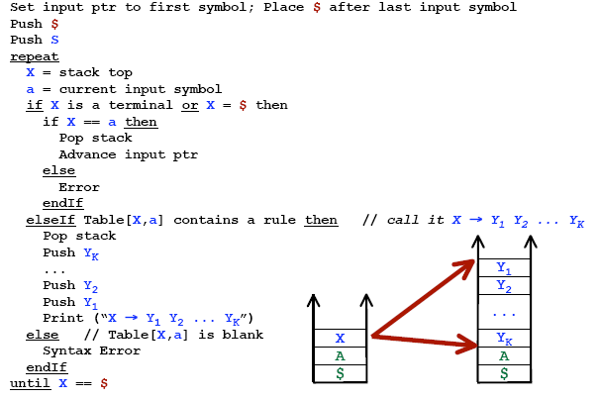
PREDICTIVE PARSING ALGORITHM

Slide 11
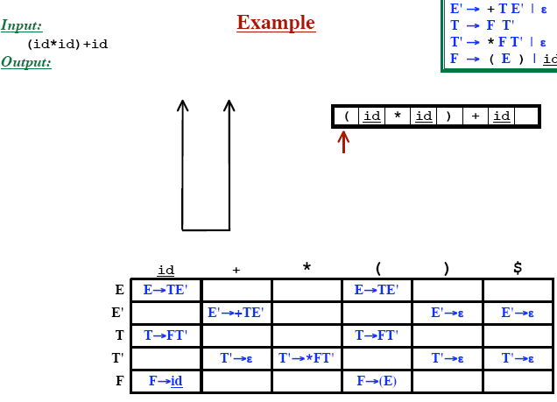
PREDICTIVE PARSING

Slide 12
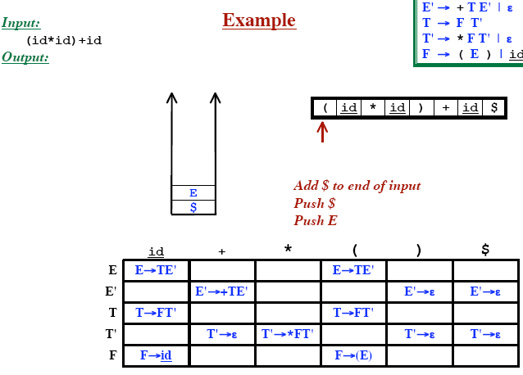
PREDICTIVE PARSING

Slide 13
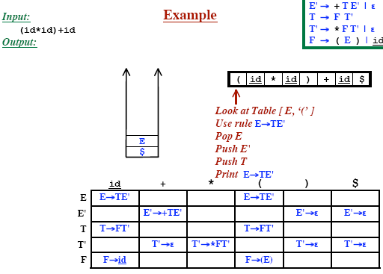
PREDICTIVE PARSING

Slide 14
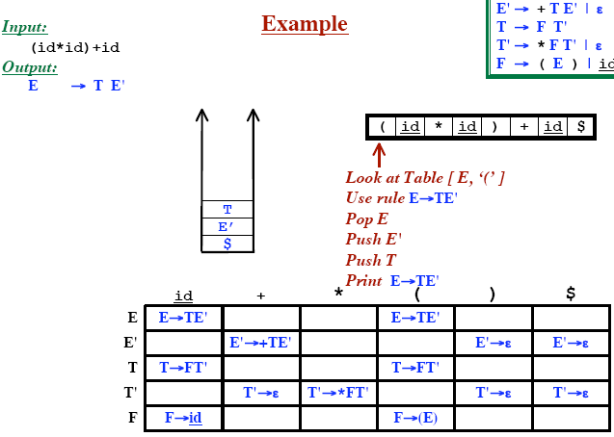
PREDICTIVE PARSING

Slide 15
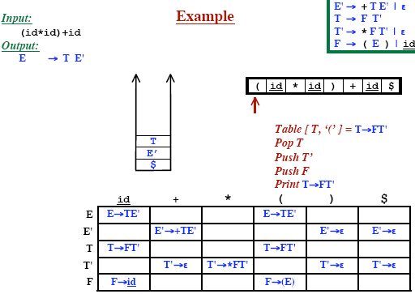
PREDICTIVE PARSING

Slide 16
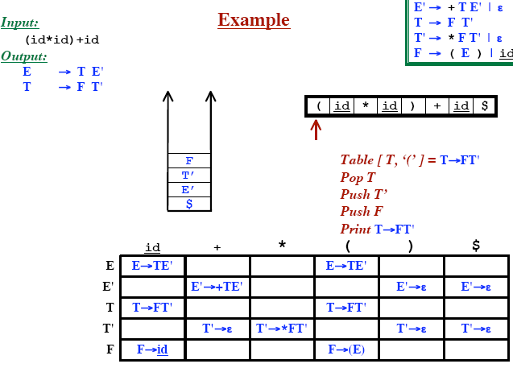
PREDICTIVE PARSING

Slide 17
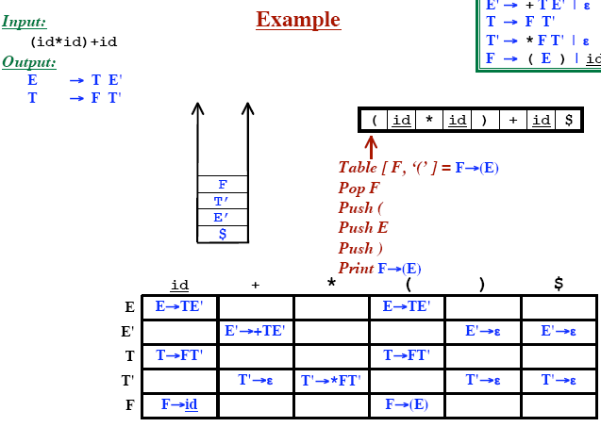
PREDICTIVE PARSING

Slide 18
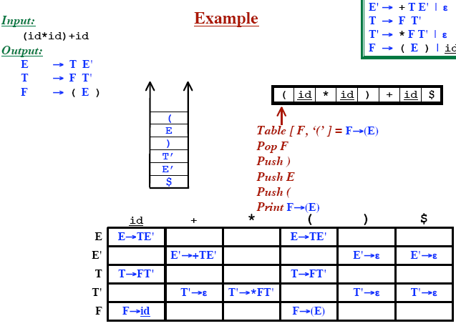
PREDICTIVE PARSING

Slide 19
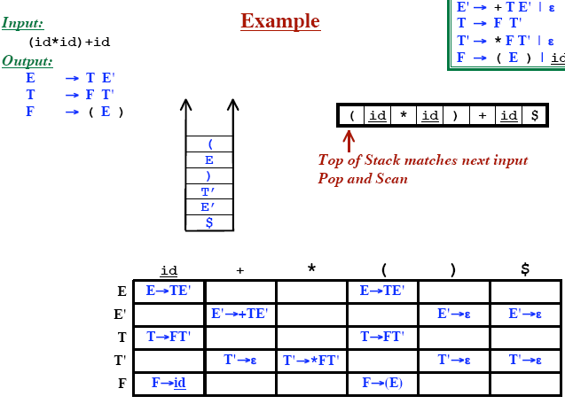
PREDICTIVE PARSING

Slide 20
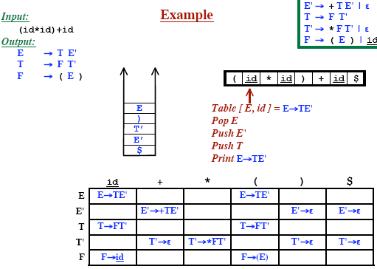
PREDICTIVE PARSING

Slide 21
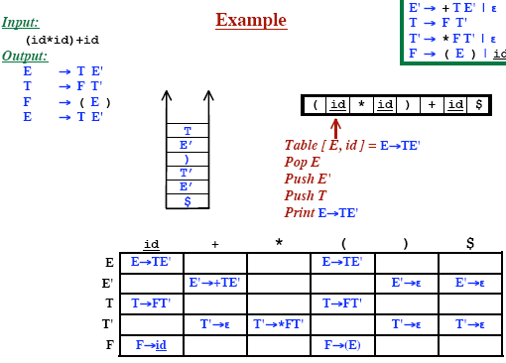
PREDICTIVE PARSING

Slide 22
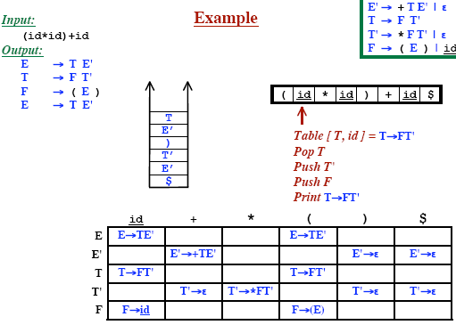
PREDICTIVE PARSING

Slide 23
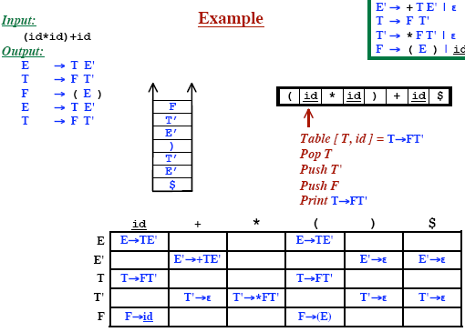
PREDICTIVE PARSING

Slide 24
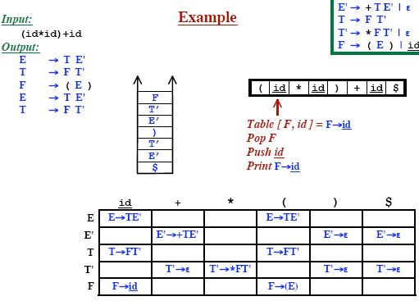
PREDICTIVE PARSING

Slide 25
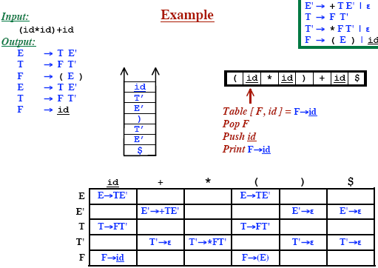
PREDICTIVE PARSING

Slide 26
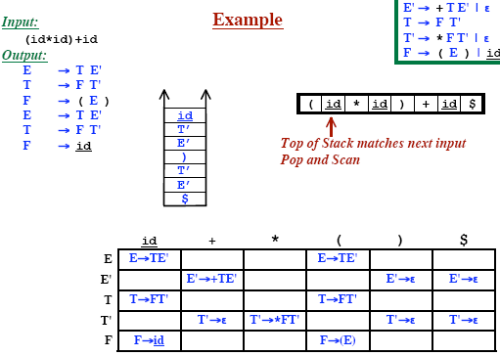
PREDICTIVE PARSING

Slide 27
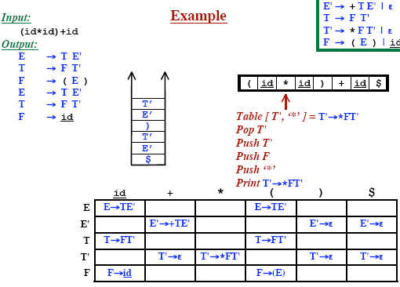
PREDICTIVE PARSING

Slide 28
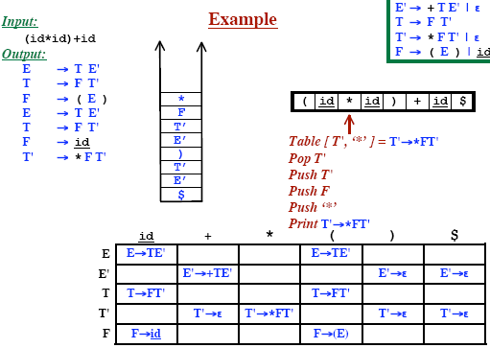
PREDICTIVE PARSING

Slide 29
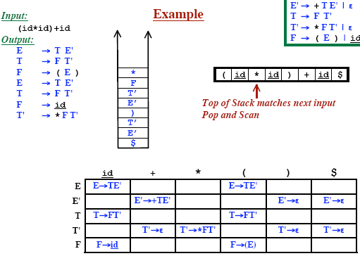
PREDICTIVE PARSING

Slide 30
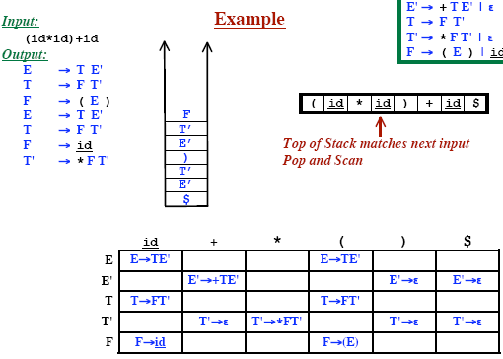
PREDICTIVE PARSING

Slide 31
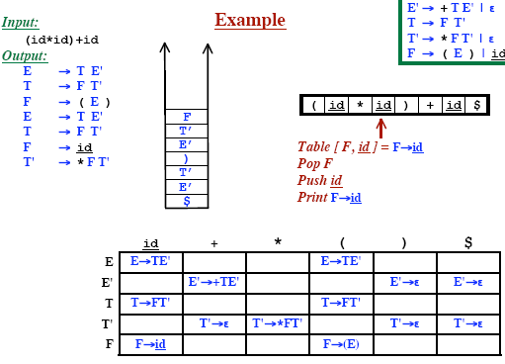
PREDICTIVE PARSING

Slide 32
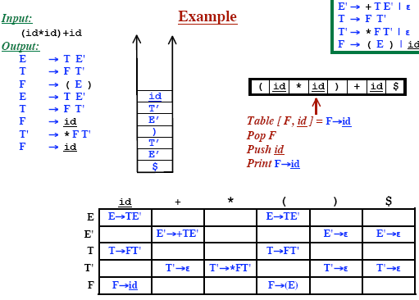
PREDICTIVE PARSING

Slide 33

PREDICTIVE PARSING

Slide 34
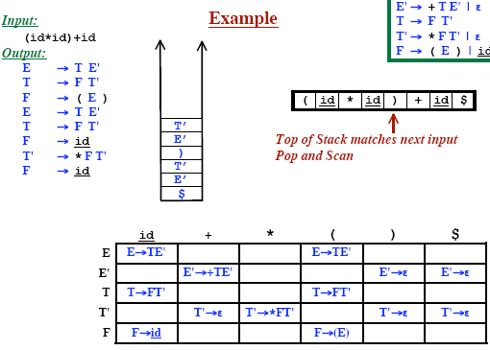
PREDICTIVE PARSING

Slide 35
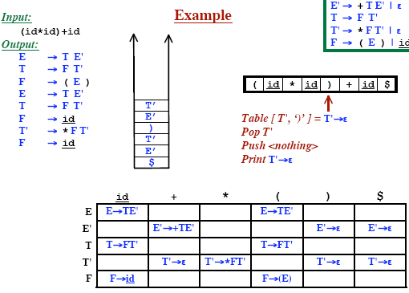
PREDICTIVE PARSING

Slide 36
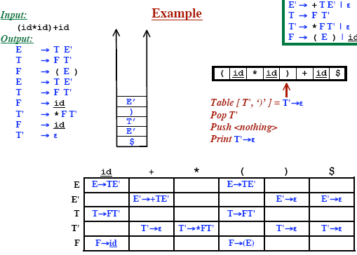
PREDICTIVE PARSING

Slide 37
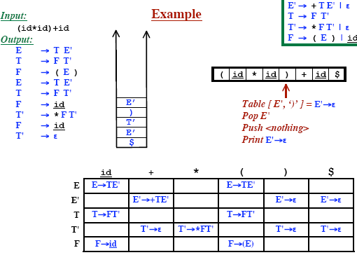
PREDICTIVE PARSING

Slide 38
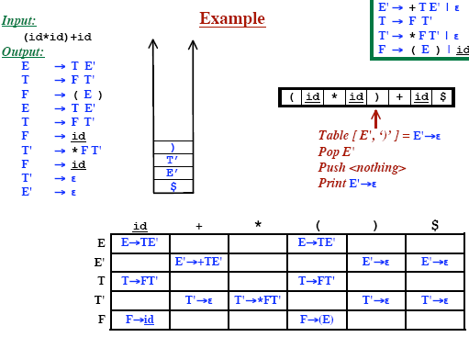
PREDICTIVE PARSING

Slide 39
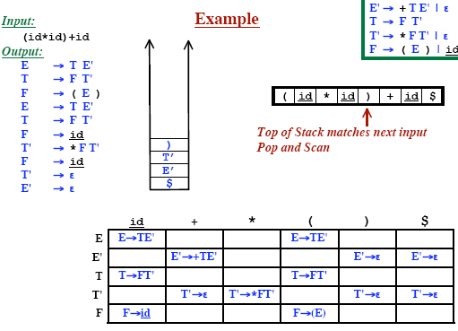
PREDICTIVE PARSING

Slide 40
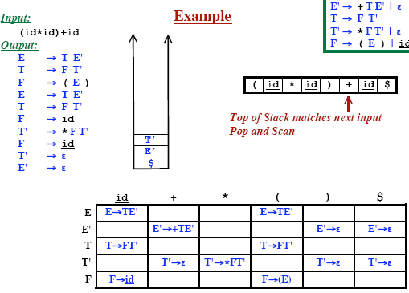
PREDICTIVE PARSING

Slide 41
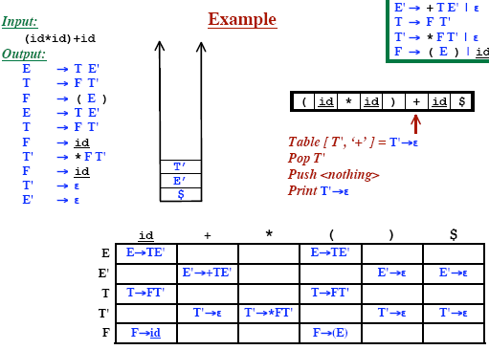
PREDICTIVE PARSING

Slide 42
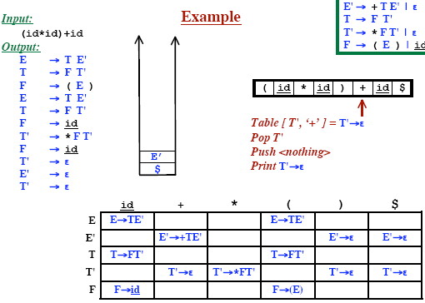
PREDICTIVE PARSING

Slide 43
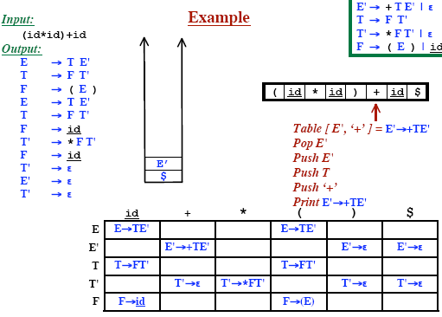
PREDICTIVE PARSING

Slide 44
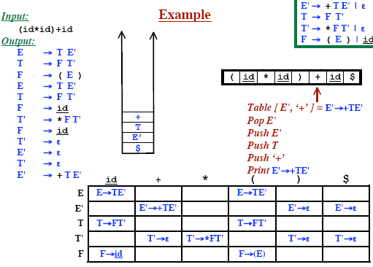
PREDICTIVE PARSING

Slide 45
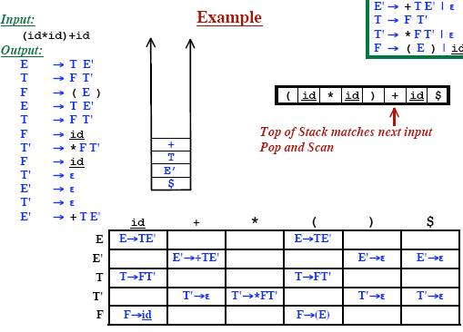
PREDICTIVE PARSING

Slide 46

PREDICTIVE PARSING

Slide 47
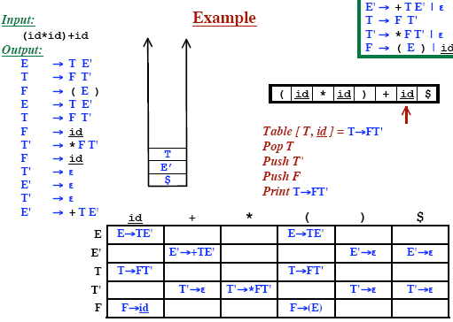
PREDICTIVE PARSING

Slide 48
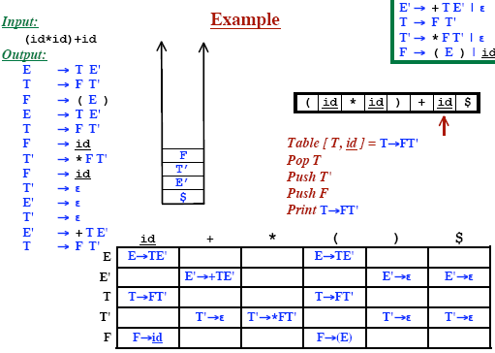
PREDICTIVE PARSING

Slide 49
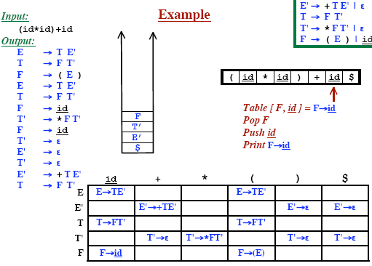
PREDICTIVE PARSING

Slide 50
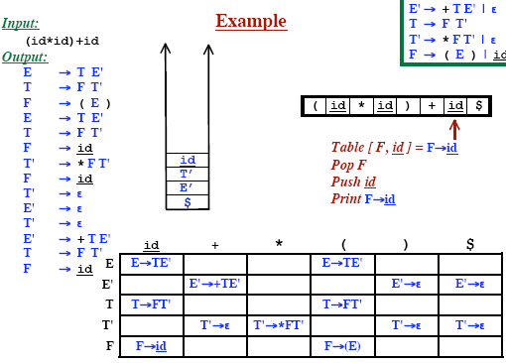
PREDICTIVE PARSING

Slide 51
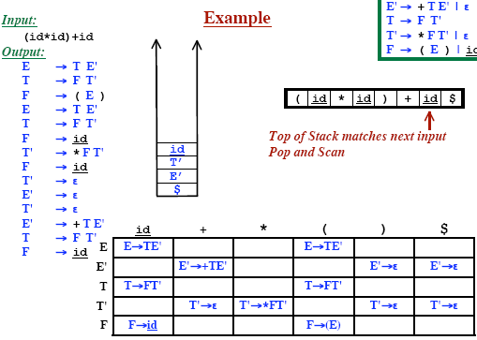
PREDICTIVE PARSING

Slide 52
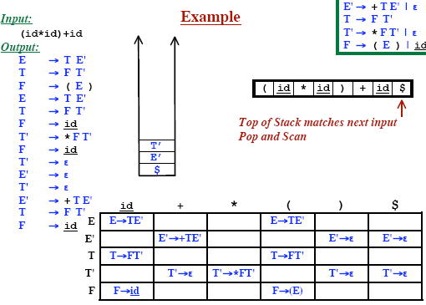
PREDICTIVE PARSING

Slide 53
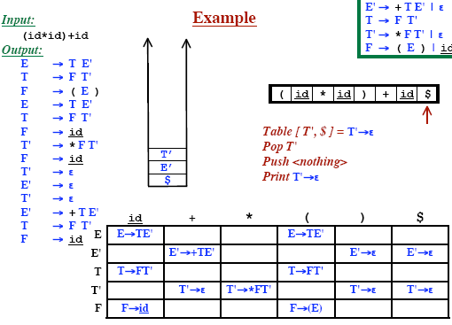
PREDICTIVE PARSING

Slide 54

PREDICTIVE PARSING

Slide 55
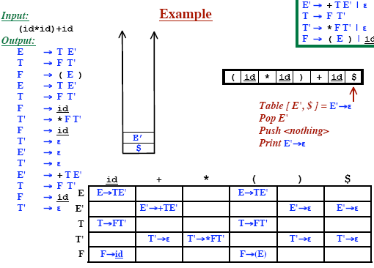
PREDICTIVE PARSING

Slide 56
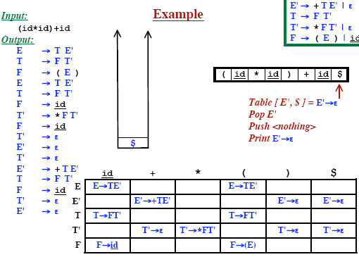
PREDICTIVE PARSING

Slide 57

PREDICTIVE PARSING

Slide 58






RECONSTRUCTING THE PARSE TREE

Slide 59


RECONSTRUCTING THE PARSE TREE

Slide 60


RECONSTRUCTING THE PARSE TREE

Slide 61

EXAMPLE: THE “DANGLING ELSE” GRAMMAR

Slide 62

EXAMPLE: THE “DANGLING ELSE” GRAMMAR

Slide 63

EXAMPLE: THE “DANGLING ELSE” GRAMMAR

Slide 64

EXAMPLE: THE “DANGLING ELSE” GRAMMAR

Slide 65

EXAMPLE: THE “DANGLING ELSE” GRAMMAR

Slide 66

EXAMPLE: THE “DANGLING ELSE” GRAMMAR

Slide 67

EXAMPLE: THE “DANGLING ELSE” GRAMMAR

Slide 68

EXAMPLE: THE “DANGLING ELSE” GRAMMAR

Slide 69

EXAMPLE: THE “DANGLING ELSE” GRAMMAR

Slide 70

EXAMPLE: THE “DANGLING ELSE” GRAMMAR

Slide 71

EXAMPLE: THE “DANGLING ELSE” GRAMMAR

Slide 72

LL(1) GRAMMAR
LL(1) Grammar
LL(1) grammars
  Are never ambiguous.
  Will never have left recursion.
Furthermore...
  If we are looking for an “A” and the next symbol is “b”,
  Then only one production must be possible
Although elimination of left recursion and left factoring is easy.
  Some grammar will never be a LL(1) grammar.

Slide 73

LL(1) GRAMMAR

Slide 74
PROPERTIES OF LL(1) GRAMMAR
A grammar G is LL(1) if an only if whenever A →α | β are two distinct productions of G the following conditions hold:
  For no terminal a do both α and β derive strings beginning with a.
  At most one of α and β can derive the empty string.
  If then β ⇒* ε , then α does not derive any string beginning with a terminal in FOLLOW(A).

Slide 75
ERROR RECOVERY
When Do Errors Occur? Recall Predictive Parser Function:
a
+
b
$
Input
Stack
X
Predictive Parsing Program
Output
Y
Z
Parsing Table M[A,a]
$
If X is a terminal and it doesn’t match input.
If M[X, Input] is empty – No allowable actions

Slide 76

ERROR RECOVERY

Slide 77

ERROR RECOVERY: SKIP INPUT SYMBOLS

Slide 78

ERROR RECOVERY: POP THE STACK

Slide 79

ERROR RECOVERY: PANIC MODE

Slide 80

ERROR RECOVERY - TABLE ENTRIES

Slide 81
QUESTIONS ?

